Slide 1

Hybrid Movie Recommendation System
Rohit Andani
Student of AI Course

Slide 2
Framework Development
Load Dataset
Preprocess Data
Content Features
Data Loading and Preprocessing
User-Item Matrix
User Similarity
Similarity Calculations
Item Similarity
User-based Filtering
Item-based Filtering
Content-based Filtering
Hybrid Approach
Recommendation Algorithms
Recommendations Output
Display Recommendations
Notes:
1. Data Loading and Preprocessing
This initial phase involves gathering the necessary data and preparing it for analysis.
Load Datasets:
Action: This step involves loading the datasets required for the recommendation system. The datasets typically include movie ratings, movie details, and tags.
Objective: To read data from CSV files or databases into a format that can be processed (e.g., a pandas DataFrame).
Preprocess Data:
Action: Data preprocessing includes handling missing values, merging datasets, and any other necessary cleaning operations.
Objective: To prepare the data for subsequent analysis and ensure it is in a consistent and usable format.
User-Item Matrix:
Action: Creating a user-item matrix where rows represent users, columns represent items (movies), and values represent the ratings given by users.
Objective: To transform the raw rating data into a structured matrix that can be used for similarity calculations.
Content Features:
Action: Extracting and combining content features (e.g., genres, tags) for each movie.
Objective: To prepare a feature matrix for content-based filtering.
2. Similarity Calculations
This phase focuses on calculating the similarity between users and between items (movies) based on the prepared data.
User Similarity:
Action: Calculating the similarity between users based on their ratings using metrics such as cosine similarity.
Objective: To identify users who have similar tastes in movies.
Item Similarity:
Action: Calculating the similarity between items (movies) based on user ratings using metrics such as cosine similarity.
Objective: To identify movies that are similar to each other based on how they are rated by users.
3. Recommendation Algorithms
This phase involves implementing various recommendation algorithms to generate personalized suggestions.
User-Based Filtering:
Action: Generating recommendations for a user by finding similar users (user similarity) and suggesting items that these similar users have liked.
Objective: To recommend items based on the preferences of users with similar tastes.
Item-Based Filtering:
Action: Generating recommendations by finding items similar to those the user has liked (item similarity).
Objective: To recommend items that are similar to the ones the user has rated highly.
Content-Based Filtering:
Action: Generating recommendations based on the content features of items that the user has liked.
Objective: To recommend items that share similar attributes (e.g., genres, tags) with the ones the user likes.
Hybrid Approach:
Action: Combining multiple recommendation algorithms (user-based, item-based, and content-based) to generate more accurate and diverse recommendations.
Objective: To leverage the strengths of different algorithms and provide better recommendations.
4. Recommendations Output
This final phase involves displaying the generated recommendations to the user.
Display Recommendations:
Action: Presenting the recommended items to the user in a user-friendly format (e.g., a list or table).
Objective: To provide the user with personalized suggestions based on their preferences and interactions.

Slide 3
About Dataset
This dataset (ml-latest-small) describes 5-star rating and free-text tagging activity from MovieLens, a movie recommendation service. It contains 100836 ratings and 3683 tag applications across 9742 movies. These data were created by 610 users between March 29, 1996 and September 24, 2018. This dataset was generated on September 26, 2018
Movie.csv Rating.csv Tag.csv
There are a total of 9742 Movie's in our dataset with 100836 Users Rating the movie and 3683 Tags.
userId: Unique Id provided for each User
userId were selected at random for inclusion. Their ids have been anonymized. User ids are consistent between ratings.csv and tags.csv (i.e., the same id refers to the same user across the two files).
movieId: Unique Id provided for each Movie
Only movies with at least one rating or tag are included in the dataset. These movie ids are consistent with those used on the MovieLens web site (e.g., id 1 corresponds to the URL Movie Lens. Movie ids are consistent between ratings.csv, tags.csv, movies.csv, and links.csv (i.e., the same id refers to the same movie across these four data files).
rating (rating.csv): Ratings are made on a 5-star scale, with half-star increments (0.5 stars - 5.0 stars).
All Ratings are contained in the file ratings.csv. Each line of this file after the header row represents one rating of one movie by one user
Mean show the average rating is 3.2-Star
genres: Genres are a pipe-separated list, and are selected from the following:
Action
Adventure
Animation
Children’s Comedy Crime Documentary Drama Fantasy Film-Noir Horror Musical Mystery Romance Sci-Fi Thriller War

Slide 4
Execution Sequence
Real time analytics with Recommendations in Dashboard with custom Input:
project_root/
│
├── app.py # Main Flask and Dash application script
├── dash_app.py # (Optional) Separate Dash app script if needed
├── templates/
│ ├── index.html # Template for the home page
│ └── recommendations.html # Template for displaying recommendations
└── requirements.txt # List of required Python packages
Real time analytics with Recommendations in text format :
ml-latest-small/ml-latest-small/Hybrid Movie Recommendation System.ipynb

Slide 5
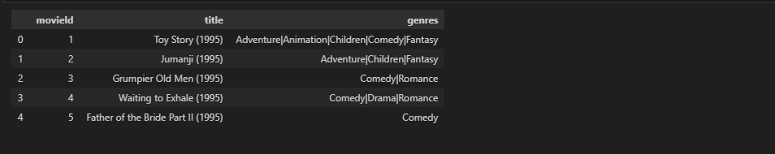
Data Visualization

Slide 6
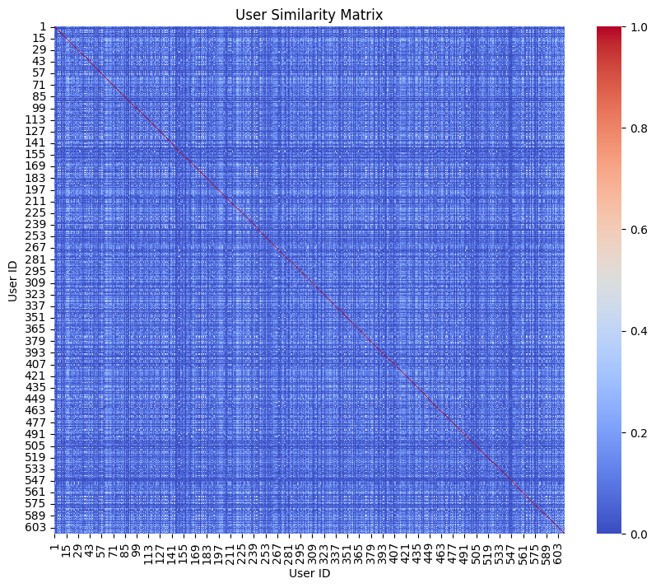
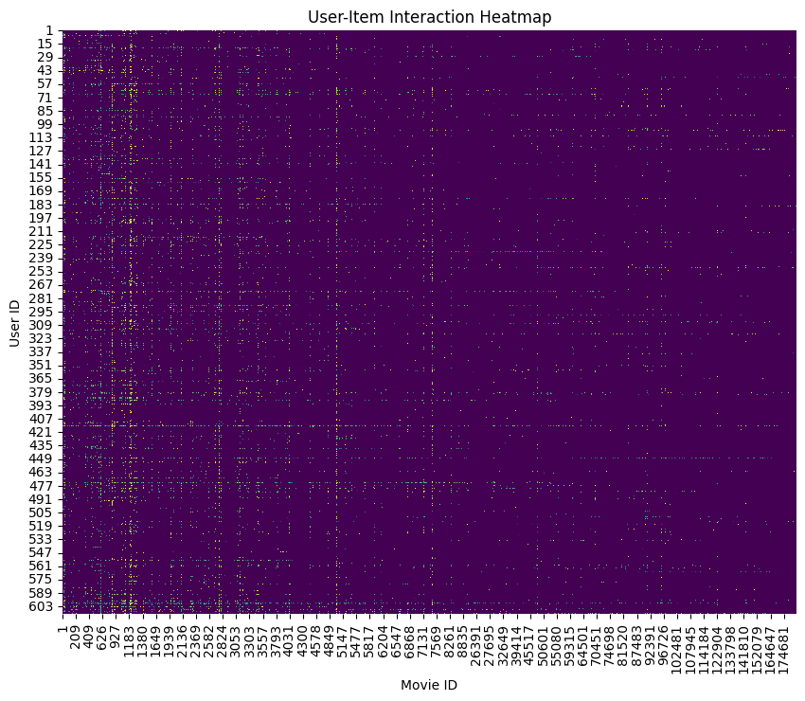
User and Item Similarity Matrix
Notes:
User Similarity Matrix: Measures how similar users are to each other based on their movie ratings. It is useful for identifying users with similar tastes and making user-based collaborative filtering recommendations.
Item Similarity Matrix: Measures how similar movies are to each other based on user ratings. It is useful for identifying movies that are similar and making item-based collaborative filtering recommendations.

Slide 7
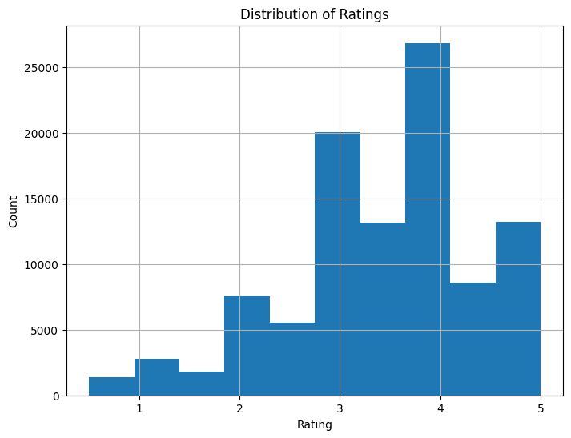
Distribution Rating

Slide 8
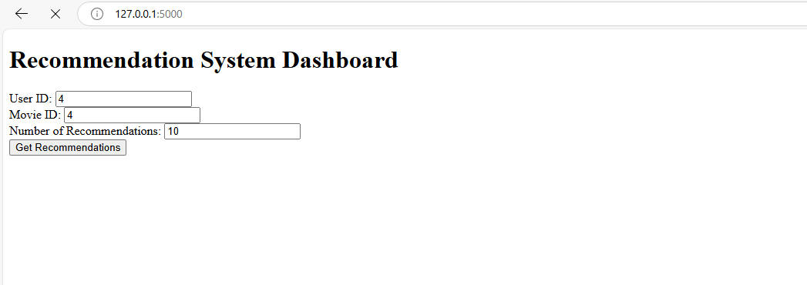
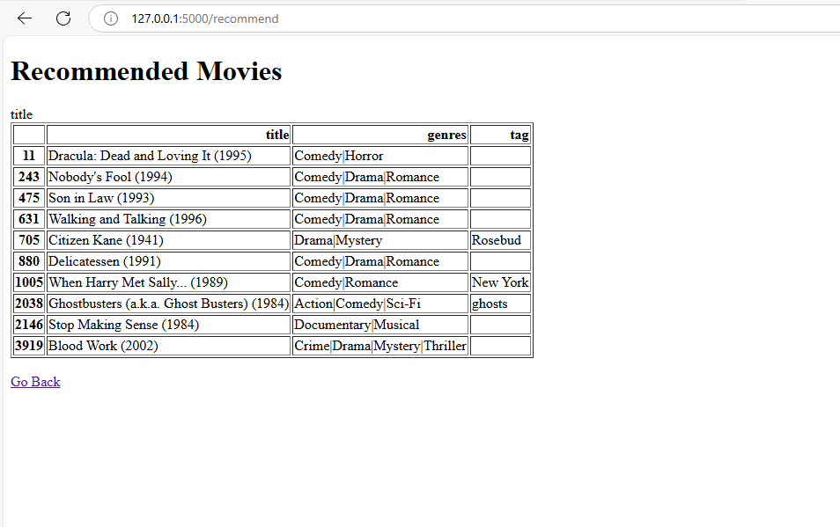
Recommendation of Movie with Text and Dashboard based Program

